Slide 1


Slide 2

Mongo
Slang term for huge

Slide 3
Huge
Can store a lot of data

Slide 4

Easy
Flexible
Scalable

Slide 5

Built for speed

Slide 6
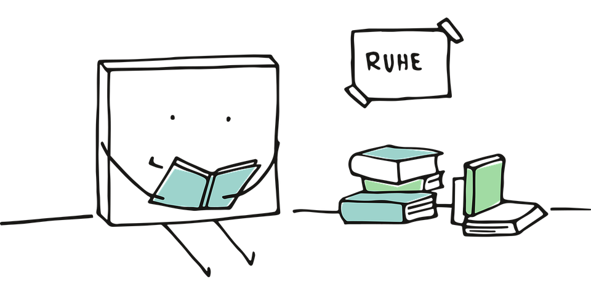
Easy readability
Rich document based queries

Slide 7
High performance
Full index support

Slide 8
High availability
Replication and failover

Slide 9
Great for
Web applications
Semi structured content management
Real time analytics
High speed logging
Caching
High scalability

Slide 10
Great for
Web
SaaS
Games
Healthcare
Finance
Government

Slide 11
NoSQL
Not only SQL

Slide 12
NoSQL
non tabular
non-relational database
stores data differently than relational tables

Slide 13
NoSQL
can store relationship data
stores differently than relational databases

Slide 14
NoSQL
Emerged in the late 2000s
As cost of storage decreased
Complex, hard to manage databases were no longer needed just to reduce data duplication

Slide 15
NoSQL
Emerged in the late 2000s
As cost of storage decreased
Complex, hard to manage databases were no longer needed just to reduce data duplication

Slide 16
4 major types of NoSQL
Document databases
store data in documents similar to JSON (JavaScript Object Notation) objects

Slide 17
4 major types of NoSQL
Key-value databases
simpler type of database
each item contains keys and values

Slide 18
4 major types of NoSQL
Wide-column databases
store data in tables, rows, and dynamic columns.

Slide 19
4 major types of NoSQL
Graph databases
store data in nodes and edges

Slide 20
NoSQL
fully supports agile development
does not statically define how the data must be modeled

Slide 21
NoSQL
Operate at any scale
Used at many companies

Slide 22
open-source
one of the widely recognised NoSQL databases
written in C++

Slide 23
Database
Collection
Collection
Document
Document
Document
Document

Slide 24
School
Courses
Students
{title: ‘Web Development’,
description: ‘Learn web development’}
{title: ‘Game Development’,
description: ‘Learn Unity and Unreal’}
{firstName: ‘Alex’,
studentID: 2991022}
{firstName: ‘John’,
studentID: 3466244}

Slide 25
physical container for collections.
gets its own set of files on the file system.
1 MongoDB server typically has multiple databases.
Database

Slide 26
Table
group of documents
does not enforce a schema.
Collection

Slide 27
Record (row)
Set of key-value pairs.
Document

Slide 28
Document
dynamic schema
documents in the same collection don’t need to have the same set of fields or structure
Document

